Slide 1
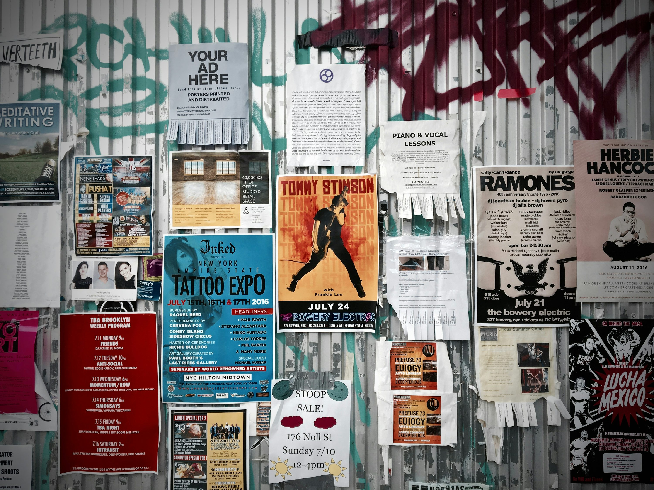
WHAT IS IT ??

Slide 2

A good poster.

Slide 3

An ugly poster.

Slide 4

INTRODUCING
.
Post
er
r
Made for your space.

Slide 5


POSTR
01 / 10
MBA E-COMMERCE PROJECT · 2026
Made for your space
PROJECT TEAM
Poojitha K
Anushka Mahato
Sriparno Chowdhury
Akshaya Tantri
POSTR · CAMPUS GIFTING REIMAGINED
CONFIDENTIAL PITCH DECK
Notes:
- POSTR is a campus-native D2C brand for personalized polaroids, posters, and photo cards.
- Built for university students, hostel residents, couples, and friendship groups.
- Four co-founders: Poojitha, Anushka, Sriparno, Akshaya — bootstrapped with ₹4,000.
- Core promise: 24–48 hour hyper-local campus delivery.

Slide 6


Market Gaps & Competitor Analysis
Where large marketplaces fall short for campus gifting
Amazon / Marketplaces
POSTR
Delivery Speed
7+ days lead time
24–48 hr campus delivery
Quality Control
Inconsistent — low-res prints, thin cardstock
Physically vendor-verified before packing
Emotional Value
Generic, one-off gift
QR memory vault + shared birthday notes
Returns / Replacement
Slow, tedious claims process
Immediate no-questions replacement
02 / 10

Slide 7




Our Unique Selling Proposition
Four differentiators that set POSTR apart from standard print shops
01
02
03
04
QR Memory Vault
Campus Birthday Pack
Eco Groove-Box
48-Hr Campus Delivery
Scannable QR on every print opens a private cloud vault (50–60 MB) storing videos, albums & tagged memories — for life.
A display-stand card with 2 personalized prints, plus space for peers to leave anonymous birthday notes.
Packaging doubles as a desk stand, pen holder or flower vase — instant utility, zero waste.
24–48 hour hyper-local delivery vs. 7+ days on Amazon, backed by a risk-free replacement guarantee.
03 / 10

Slide 8
D2C Business Model & Tiered Pricing
Direct-to-consumer storefront, optimized for campus youth and gift-shoppers — three combo tiers priced against actual sourcing cost
Tier
Contents
Unit Cost*
Price Range
Gross Margin
Classic Pack
(Entry Tier)
5 custom polaroids + wooden clips & twine set
≈ ₹37
₹149 – ₹179
~75%
Premium Pack
(High Margin)
1 A4 poster + 3 polaroids + micro-LED lights + QR vault + groove box
≈ ₹143
₹399 – ₹449
~66%
Deluxe Combo
(Couples / Groups)
2 A3 posters (bulk rate) + 6 polaroids + 2× LED lights + 2× groove box + QR vault
≈ ₹212
₹599 – ₹699
~68%
*Unit cost derived from local vendor benchmarks: A3/A4 print ₹20–₹50/pc, polaroid ₹4.43/pc (₹155 per 35), clips & twine ≈₹15/pack, LED lights ₹35–₹50/unit, groove box ≈₹25/unit.
04 / 10

Slide 9



Digital Infrastructure & Technology Stack
Software powering the storefront, payments, and digital memory vaults
Frontend E-Commerce Engine
Mobile-first storefront for rapid catalog browsing, custom photo-upload management, and checkout.
Shopify
Payment Processing
Integrated payment gateway for instant, frictionless mobile payments popular among university students.
UPI · Razorpay · Paytm
Virtual Memory Storage Backend
QR landing engine routed to cloud storage buckets allocated per custom QR order ID.
Virtual storage
05 / 10

Slide 10
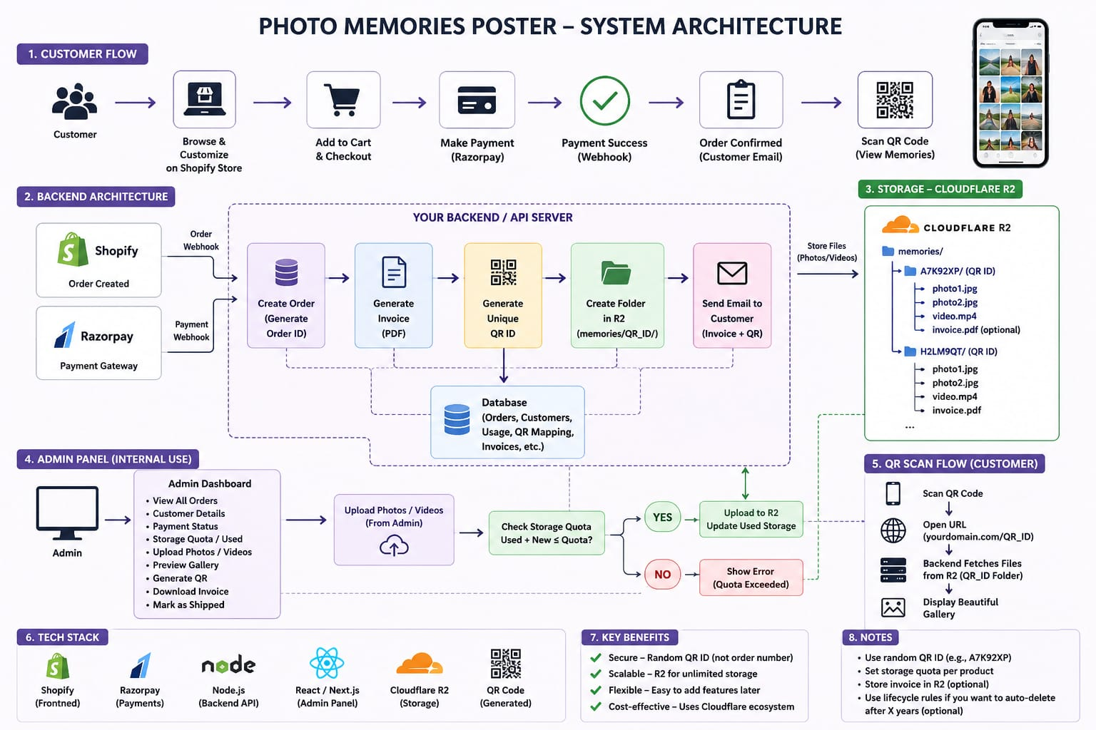

Slide 11
Bootstrapped Capital & Fund Allocation
Equal co-founder funding structure and budget distribution
Inventory & Supplies 80% ₹3200
TOTAL CAPITAL
₹4,000
Photo paper stock, micro-LED lights, clips, cardboard packaging.
Raised equally among 4 students
Software & Tech Infrastructure 20% · ₹800
₹1,000
Shopify trial domain, hosting, virtual storage
contribution per person
06 / 10

Slide 12
Feasibility Analysis: Cost Structure & Unit Economics
Supplier cost benchmarks and gross margin by combo tier
SUPPLIER COST BENCHMARKS
COST vs. PRICE BY TIER (₹)
A3/A4 print — single (1 pc)
₹50 / pc
A3/A4 print — bulk (50 pcs, 1 side)
₹20 / pc
Polaroid print (bulk, 35 pcs)
₹4.43 / pc
Photo clips and set
≈ ₹150 / bulk set
Micro-LED fairy lights
₹35 – ₹50 / unit
Eco groove-box packaging
≈ ₹25 / unit
Zero inventory-holding risk: on-demand printing via local vendor tie-ups means no unsold stock exposure.
07 / 10

Slide 13



Feasibility Analysis: Operations & Sourcing Risk
On-demand inventory, local vendor tie-ups, and quality assurance protocol
Zero Inventory-Holding Risk
Quality Assurance Protocol
Low Supply-Chain Risk
On-demand printing with local vendor tie-ups eliminates unsold-stock exposure entirely.
Every print is physically verified with local suppliers before packing — guaranteeing high resolution and zero paper defects.
Multi-vendor local sourcing prevents production bottlenecks and guarantees the 24–48 hour fulfillment promise.
08 / 10

Slide 14

Execution Plan: 4-Week Operational Roadmap
From teaser launch to full campus rollout
WEEK 1
WEEK 2
WEEK 3
WEEK 4
Marketing
Order Processing & Fast Fulfillment
Product Line Expansion
Review, Scale & Optimize
1
2
3
4
Campus promotions, Instagram campaign roll-out, and Shopify storefront activation.
Begin accepting orders, initiate local vendor printing, launch 24–48 hr campus delivery.
Introduce special Combo Packs and launch the Campus Birthday Pack.
Collect testimonials, expand word-of-mouth campaigns, optimize unit production costs.
Milestone at Week 4: a repeatable weekly fulfillment cycle, an expanded product line, and a testimonial base ready to fuel word-of-mouth growth into the next term.
09 / 10

Slide 15
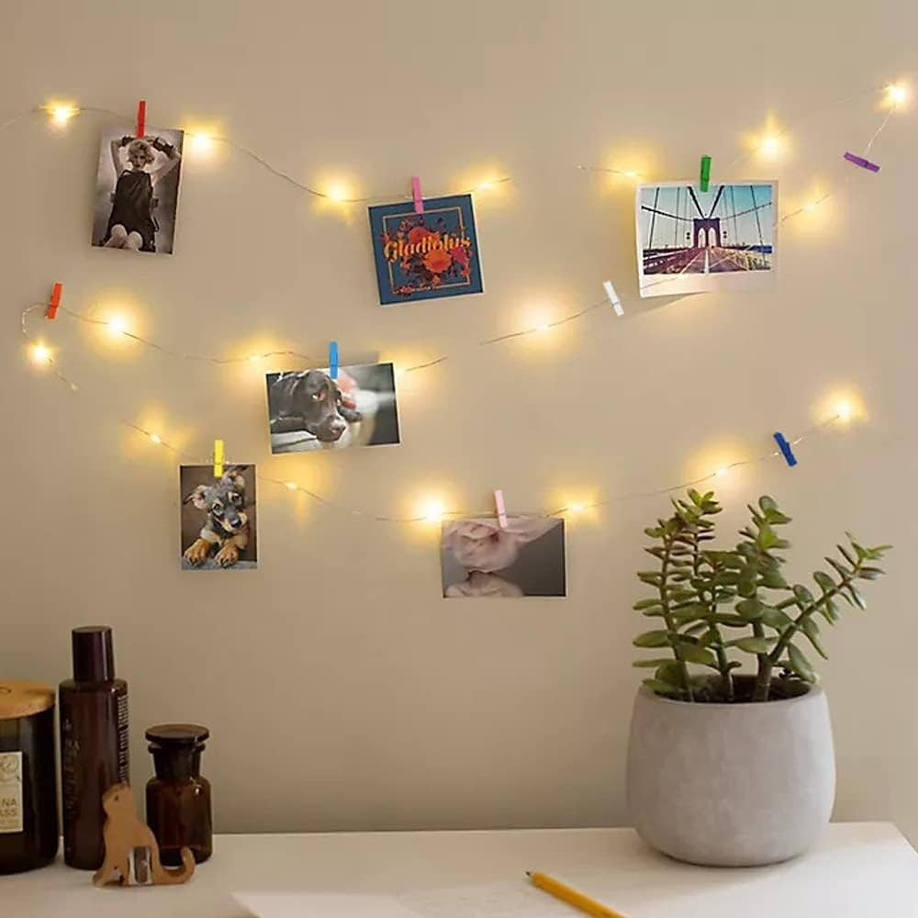
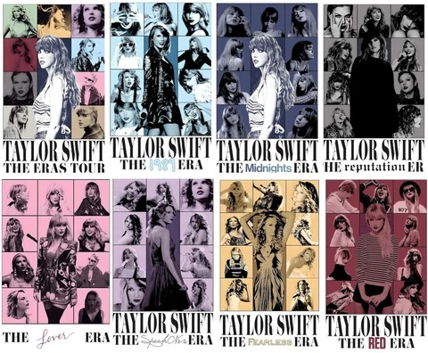


THANK YOU

